Slide 1
Biconnected Components

Slide 2
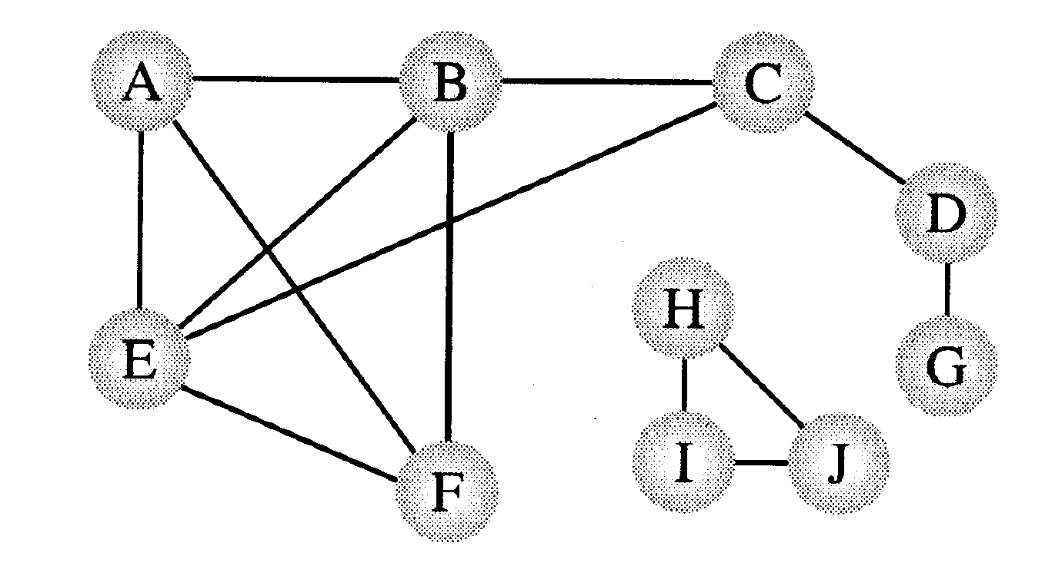
Connectivity/Biconnectivity
A node and all the nodes reachable from it compose a connected component. A graph is called connected if it has only one connected component.
Since the function visit() of DFS visits every node that is reachable and has not already been visited, the DFS can easily be modified to print out the connected components of a graph.
Two connected components

Slide 4
Connectivity/Biconnectivity
In actual uses of graphs, such as networks, we need to establish not only that every node is connected to every other node, but also there are at least two independent paths between any two nodes. A maximum set of nodes for which there are two different paths is called biconnected.
{H,I,J} and {A,B,C,E,F} are biconnected.

Slide 5
Connectivity/Biconnectivity
Another way to define this concept is that there are no single points of failure, no nodes that when deleted along with any adjoining arcs, would split the graph into two or more separate connected components. Such a node is called an articulation point.
If a graph contains no articulation points, then it is biconnected. If a graph does contain articulation points, then it is useful to split the graph into the pieces where each piece is a maximal biconnected subgraph called a biconnected component.

Slide 6

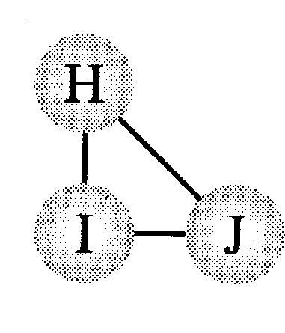
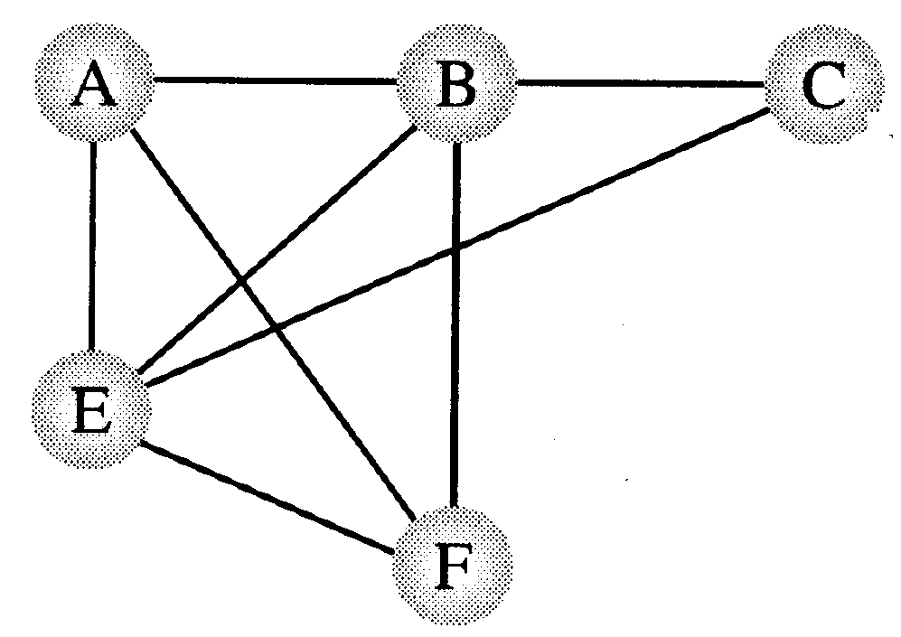
Connectivity/Biconnectivity
Articulation points
Three biconnected components

Slide 7
Finding Articulations
Problem:
  Given any graph G = (V, E), find all the articulation points.
  Possible strategy:
    For all vertices v in V:
    Remove v and its incident edges
    Test connectivity using a DFS.
    Execution time: Θ(n(n+m)).
    Can we do better?

Slide 8
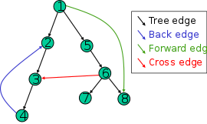
Finding Articulations

Slide 9
internal vertex u
Consider an internal vertex u
  Not a leaf,
  Assume it is not the root
Let v1, v2,…, vk denote the children of u
  Each is the root of a subtree of DFS
  If for some child, there is no back edge from any node in this subtree going to a proper ancestor of u, then u is an articulation point
u
Here u is an articulation point

Slide 10
internal vertex u
u
Here u is not an articulation point
  A back edge from every subtree of u to proper ancestors of u exists

Slide 11
What if u is a leaf
A leaf is never an articulation point
A leaf has no subtrees..

Slide 12
What about the root?
the root is an articulation point if and only if it has two or more children.
  Root has no proper ancestor
  There are no cross edges between its subtrees
This root is an articulation point

Slide 13
How to find articulation points?
Keep track of all back edges from each subtree?
  Too expensive
Keep track of the back edge that goes highest in the tree (closest to the root)
  If any back edge goes to an ancestor of u, this one will.
What is closest to root?
  Smallest discovery time

Slide 14
Finding Articulation Points
A DFS tree can be used to discover articulation points in Θ(n + m) time.
A
A
E
E
B
B
D
D
I
I
C
F
C
F
H
H
G
A
G
B
C
Can you characterize D ?
D
F
E
G
H
I

Slide 15
Depth First Search number
A
B
C
F
G =(V, E)
D
E
1
A
2
A B C D E F
1 2 3 6 5 4
B
6
3
D
C
F
4
E
5
Any relation between Discovery time and articulation point ?

Slide 16
A
1
B
2
Assume that (a,b) ⇔ a → b
Tree edge : (a,b) a < b
Back edge : (a,b) a > b
6
3
D
C
F
4
E
5
w’
v
If there is a back edge from x
to a proper ancestor of v,
then v is reachable from x.
w
x

Slide 17
Finding Articulation Points
A DFS tree can be used to discover articulation points in Θ(n + m) time.
  We start with a program that computes a DFS tree labeling the vertices with their discovery times.
  We also compute a function called low(v) that can be used to characterize each vertex as an articulation or non-articulation point.
  The root of the DFS tree will be treated as a special case:
    The root has a d[] value of 1.

Slide 18
Finding Articulation Points
The root of the DFS tree is an articulation point if and only if it has two or more children.
  Suppose the root has two or more children.
    Recall that back edges never link vertices between two different subtrees.
    So, the subtrees are only linked through the root vertex and its removal will cause two or more connected components (i.e. the root is an articulation point).
  Suppose the root is an articulation point.
    This means that its removal would produce two or more connected components each previously connected to this root vertex.
    So, the root has two or more children.

Slide 19
Definition of low(v)
  Definition. The value of low(v) is the discovery time of the vertex closest to the root and reachable from v by following zero or more tree edges downward, and then at most one back edge.
  We can efficiently compute Low by performing a postorder traversal of the depth-first spanning tree.
  low[v] = min{
  d[v],
  lowest d[w] among all back edges (v,w)
  lowest low[w] among all tree edges (v,w)
  }
  In English: low(v) < d[v] indicates if there is another way to reach v which is not via its parent

Slide 20
Definition of low(v)
Once Low[u] is computed for all vertices u, we can test whether a nonroot vertex u is an articulation point
u is an articulation point iff it has a child v for which Low[v] >= d[u]

Slide 21
Example
Calculate the discovering time of each node
1
a
a
e
i
2
b
8
e
b
f
j
3
c
9
i
c
g
10
4
d
7
f
j
d
h
5
h
6
g

Slide 22
Example
Initialize Low of each node
  Low[u] = d[u]
1
a
1
a
e
i
2
b
2
8
e
8
b
f
j
3
c
3
9
i
9
c
g
10
10
4
d
4
7
f
7
j
d
h
5
h
5
6
g
6
  low[v] = min{
  d[v],
  lowest d[w] among all back edges (v,w)
  lowest low[w] among all tree edges (v,w)
  }

Slide 23
Example
Travers the tree in post-order
Left, Right, Root
1
a
1
a
e
i
2
b
2
8
e
8
b
f
j
3
c
3
9
i
9
c
g
10
10
4
d
4
7
f
7
j
d
h
So, Node Low[g]
=min{ d[g],
min all d[w]
min all low [w]}
=min { 6, 3, NA}
= 3
5
h
5
6
g
6
3
  low[v] = min{
  d[v],
  lowest d[w] among all back edges (v,w)
  lowest low[w] among all tree edges (v,w)
  }

Slide 24
Example
Travers the tree in post-order
Left, Right, Root
1
a
1
a
e
i
2
b
2
8
e
8
b
f
j
3
c
3
9
i
9
c
g
10
10
4
d
4
7
f
7
j
d
h
Next, Node Low[h]
=min{ d[h],
min all d[w]
min all low [w]}
=min { 5, 3, 3}
= 3
5
h
5
3
6
g
3
  low[v] = min{
  d[v],
  lowest d[w] among all back edges (v,w)
  lowest low[w] among all tree edges (v,w)
  }

Slide 25
Example
Travers the tree in post-order
Left, Right, Root
1
a
1
a
e
i
2
b
2
8
e
8
b
f
j
3
c
3
9
i
9
c
g
10
10
4
d
4
7
f
7
j
d
h
3
Next, Node Low[d]
=min{ d[d],
min all d[w]
min all low [w]}
=min { 4, 3, 3}
= 3
5
h
3
6
g
3
  low[v] = min{
  d[v],
  lowest d[w] among all back edges (v,w)
  lowest low[w] among all tree edges (v,w)
  }

Slide 26
Example
Travers the tree in post-order
Left, Right, Root
1
a
1
a
e
i
2
b
2
8
e
8
b
f
j
3
c
3
9
i
9
c
g
10
10
4
d
3
7
f
7
j
d
h
1
Next, Node Low[f]
=min{ d[f],
min all d[w]
min all low [w]}
=min { 7, 1,NA}
= 1
5
h
3
6
g
3
  low[v] = min{
  d[v],
  lowest d[w] among all back edges (v,w)
  lowest low[w] among all tree edges (v,w)
  }

Slide 27
Example
Travers the tree in post-order
Left, Right, Root
1
a
1
a
e
i
2
b
2
8
e
8
b
f
j
1
3
c
3
9
i
9
c
g
10
10
4
d
3
7
f
1
j
d
h
Next, Node Low[c]
=min{ d[c],
min all d[w]
min all low [w]}
=min { 3, 1, 1}
= 1
5
h
3
6
g
3
  low[v] = min{
  d[v],
  lowest d[w] among all back edges (v,w)
  lowest low[w] among all tree edges (v,w)
  }

Slide 28
Example
Travers the tree in post-order
Left, Right, Root
1
a
1
a
e
i
2
b
2
8
e
8
b
f
j
1
3
c
1
9
i
9
c
g
10
10
4
d
3
7
f
1
j
d
h
Next, Node Low[b]
=min{ d[b],
min all d[w]
min all low [w]}
=min { 2, 1, 1}
= 1
5
h
3
6
g
3
  low[v] = min{
  d[v],
  lowest d[w] among all back edges (v,w)
  lowest low[w] among all tree edges (v,w)
  }

Slide 29
Example
Travers the tree in post-order
Left, Right, Root
1
a
1
a
e
i
2
b
1
8
e
8
b
f
j
3
c
1
9
i
9
c
g
10
10
8
4
d
3
7
f
1
j
d
h
Next, Node Low[j]
=min{ d[j],
min all d[w]
min all low [w]}
=min { 10, 8, NA}
= 8
5
h
3
6
g
3
  low[v] = min{
  d[v],
  lowest d[w] among all back edges (v,w)
  lowest low[w] among all tree edges (v,w)
  }

Slide 30
Example
Travers the tree in post-order
Left, Right, Root
1
a
1
a
e
i
2
b
1
8
e
8
b
f
j
3
c
1
9
i
9
8
c
g
10
8
4
d
3
7
f
1
j
d
h
Next, Node Low[i]
=min{ d[i],
min all d[w]
min all low [w]}
=min { 9, 8, 8}
= 8
5
h
3
6
g
3
  low[v] = min{
  d[v],
  lowest d[w] among all back edges (v,w)
  lowest low[w] among all tree edges (v,w)
  }

Slide 31
Example
Travers the tree in post-order
Left, Right, Root
1
a
1
a
e
i
2
b
1
8
e
8
b
f
j
No Change
3
c
1
9
i
8
c
g
10
8
4
d
3
7
f
1
j
d
h
Next, Node Low[e]
=min{ d[e],
min all d[w]
min all low [w]}
=min { 8, 8, 8}
= 8
5
h
3
6
g
3
  low[v] = min{
  d[v],
  lowest d[w] among all back edges (v,w)
  lowest low[w] among all tree edges (v,w)
  }

Slide 32
Example
1
a
1
a
e
i
No Change
2
b
1
8
e
8
b
f
j
3
c
1
9
i
8
c
g
10
8
4
d
3
7
f
1
j
d
h
Next, Node Low[a]
=min{ d[e],
min all d[w]
min all low [w]}
=min { 1, NA,1}
= 1
5
h
3
6
g
3
  low[v] = min{
  d[v],
  lowest d[w] among all back edges (v,w)
  lowest low[w] among all tree edges (v,w)
  }

Slide 33
Example
1
a
1
a
a
e
i
2
b
1
8
e
8
b
f
j
3
c
1
9
i
8
c
g
10
8
4
d
3
7
f
1
j
d
h
Node a,
It is Root & it has more than one child so it is an articulation point
5
h
3
6
g
3
u is an articulation point iff it has a child v for which Low[v] >= d[u]

Slide 34
Example
1
a
1
a
e
i
2
b
1
8
e
8
b
f
j
3
c
1
9
i
8
c
g
10
8
4
d
3
7
f
1
j
d
h
Node b,
Has only one child c &
Low[c] < d[b], so it is not an articulation point
5
h
3
6
g
3
u is an articulation point iff it has a child v for which Low[v] >= d[u]

Slide 35
Example
1
a
1
a
e
i
2
b
1
8
e
8
b
f
j
3
c
c
1
9
i
8
c
g
10
8
4
d
3
7
f
1
j
d
h
Node c,
Has Two child d & f, also Low[d] >= d[c], so it is an articulation point
5
h
3
6
g
3
u is an articulation point iff it has a child v for which Low[v] >= d[u]

Slide 36
Example
1
a
1
a
e
i
2
b
1
8
e
8
b
f
j
3
c
c
1
9
i
8
c
g
10
8
4
d
3
7
f
1
j
d
h
Node d,
Has Only one child h &
Low[h] < d[d], so it is not an articulation point
5
h
3
6
g
3
u is an articulation point iff it has a child v for which Low[v] >= d[u]

Slide 37
Example
1
a
1
a
e
i
2
b
1
8
e
8
b
f
j
3
c
c
1
9
i
8
c
g
10
8
4
d
3
7
f
1
j
d
h
Node h,
Has Only one child g &
Low[g] < d[h], so it is not an articulation point
5
h
3
6
g
3
u is an articulation point iff it has a child v for which Low[v] >= d[u]

Slide 38
Example
1
a
1
a
e
i
2
b
1
8
e
8
b
f
j
3
c
c
1
9
i
8
c
g
10
8
4
d
3
7
f
1
j
d
h
Node g, f & j,
Is the leaf node so these node aren’t articulation point
5
h
3
6
g
3
u is an articulation point iff it has a child v for which Low[v] >= d[u]

Slide 39
Example
1
a
1
a
e
i
2
b
1
8
e
e
8
b
f
j
3
c
c
1
9
i
8
c
g
10
8
4
d
3
7
f
1
j
d
h
Node e,
Has Only one child i,
Low[i] >= d[e], so it is an articulation point
5
h
3
6
g
3
u is an articulation point iff it has a child v for which Low[v] >= d[u]

Slide 40
Example
1
a
1
a
e
i
2
b
1
8
e
e
8
b
f
j
3
c
c
1
9
i
8
c
g
10
8
4
d
3
7
f
1
j
d
h
Node i,
Has Only one child j,
Low[j] < d[i], so it is not an articulation point
5
h
3
6
g
3
u is an articulation point iff it has a child v for which Low[v] >= d[u]

Slide 41
Articulation Points: Pseudocode
Data: color[V], time, prev[V],d[V], f[V], low[V]
DFS(G) // where prog starts
{
for each vertex u ∈ V
{
color[u] = WHITE;
prev[u]=NIL;
low[u]=inf;
f[u]=inf; d[u]=inf;
}
time = 0;
for each vertex u ∈ V
if (color[u] == WHITE)
DFS_Visit(u);
}

Slide 42
Articulation Points: Pseudocode
DFS_Visit(v)
{ color[v]=GREY;time=time+1;d[v] = time;
low[v]= d[v];
for each w ∈ Adj[v]{
if(color[w] == WHITE){
prev[w]=u;
DFS_Visit(w);
if low[w] >= d[v]
record that vertex v is an articulation
if (low[w] < low[v])
low[v] := low[w];
}
else if w is not the parent of v then
//--- (v,w) is a BACK edge
` if (d[w] < low[v])
low[v] := d[w];
}
color[v] = BLACK; time = time+1; f[v] = time;
}

Slide 43
Source
  Mark Allen Weiss – Data Structure and Algorithm Analysis in C
    Articulation Point
Notes:
(u,v) is a bridge if LOW(v) > d[u]

Slide 44
Example
1
a
1
a
e
i
2
b
1
8
e
8
b
f
j
3
c
1
9
i
8
c
g
10
8
4
d
3
7
f
1
j
d
h
Prove that only tree edge can be a bridge.
5
h
3
6
g
3
A bridge is an edge in a connected graph whose removal makes it disconnected
(u,v) is a bridge if LOW(v) > d[u]

Slide 45
Example
1
a
1
a
e
i
2
b
1
8
e
8
b
f
j
3
c
1
9
i
8
c
g
10
8
4
d
3
7
f
1
j
d
h
Edge a → b,
Low[b] <= d[a]
So, Not a Bridge
5
h
3
6
g
3
A bridge is an edge in a connected graph whose removal makes it disconnected
(u,v) is a bridge if LOW(v) > d[u]

Slide 46
Example
1
a
1
a
e
i
2
b
1
8
e
8
b
f
j
3
c
1
9
i
8
c
g
10
8
4
d
3
7
f
1
j
d
h
Edge b → c,
Low[c] <= d[b]
So, Not a Bridge
5
h
3
6
g
3
A bridge is an edge in a connected graph whose removal makes it disconnected
(u,v) is a bridge if LOW(v) > d[u]

Slide 47
Example
1
a
1
a
e
i
2
b
1
8
e
8
b
f
j
3
c
1
9
i
8
c
g
10
8
4
d
3
7
f
1
j
d
h
Edge c → f,
Low[f] <= d[c]
So, Not a Bridge
5
h
3
6
g
3
A bridge is an edge in a connected graph whose removal makes it disconnected
(u,v) is a bridge if LOW(v) > d[u]

Slide 48
Example
1
a
1
a
e
i
2
b
1
8
e
8
b
f
j
3
c
1
9
i
8
c
g
10
8
4
d
3
7
f
1
j
d
h
Edge c → d,
Low[d] <= d[c]
So, Not a Bridge
5
h
3
6
g
3
A bridge is an edge in a connected graph whose removal makes it disconnected
(u,v) is a bridge if LOW(v) > d[u]

Slide 49
Example
1
a
1
a
e
i
2
b
1
8
e
8
b
f
j
3
c
1
9
i
8
c
g
10
8
4
d
3
7
f
1
j
d
h
Edge d → h,
Low[h] <= d[d]
So, Not a Bridge
5
h
3
6
g
3
A bridge is an edge in a connected graph whose removal makes it disconnected
(u,v) is a bridge if LOW(v) > d[u]

Slide 50
Example
1
a
1
a
e
i
2
b
1
8
e
8
b
f
j
3
c
1
9
i
8
c
g
10
8
4
d
3
7
f
1
j
d
h
Edge h → g,
Low[g] <= d[h]
So, Not a Bridge
5
h
3
6
g
3
A bridge is an edge in a connected graph whose removal makes it disconnected
(u,v) is a bridge if LOW(v) > d[u]

Slide 51
Example
1
a
1
a
e
i
2
b
1
8
e
8
b
f
j
3
c
1
9
i
8
c
g
10
8
4
d
3
7
f
1
j
d
h
Edge a → e,
Low[e] > d[a]
So, Is a Bridge
5
h
3
6
g
3
A bridge is an edge in a connected graph whose removal makes it disconnected
(u,v) is a bridge if LOW(v) > d[u]

Slide 52
Example
1
a
1
a
e
i
2
b
1
8
e
8
b
f
j
3
c
1
9
i
8
c
g
10
8
4
d
3
7
f
1
j
d
h
Edge e → i,
Low[i] <= d[e]
So, Not a Bridge
5
h
3
6
g
3
A bridge is an edge in a connected graph whose removal makes it disconnected
(u,v) is a bridge if LOW(v) > d[u]

Slide 53
Example
1
a
1
a
e
i
2
b
1
8
e
8
b
f
j
3
c
1
9
i
8
c
g
10
8
4
d
3
7
f
1
j
d
h
Edge i → i,
Low[j] <= d[i]
So, Not a Bridge
5
h
3
6
g
3
A bridge is an edge in a connected graph whose removal makes it disconnected
(u,v) is a bridge if LOW(v) > d[u]

